Slide 1
Traveling
Exhibition

Slide 2
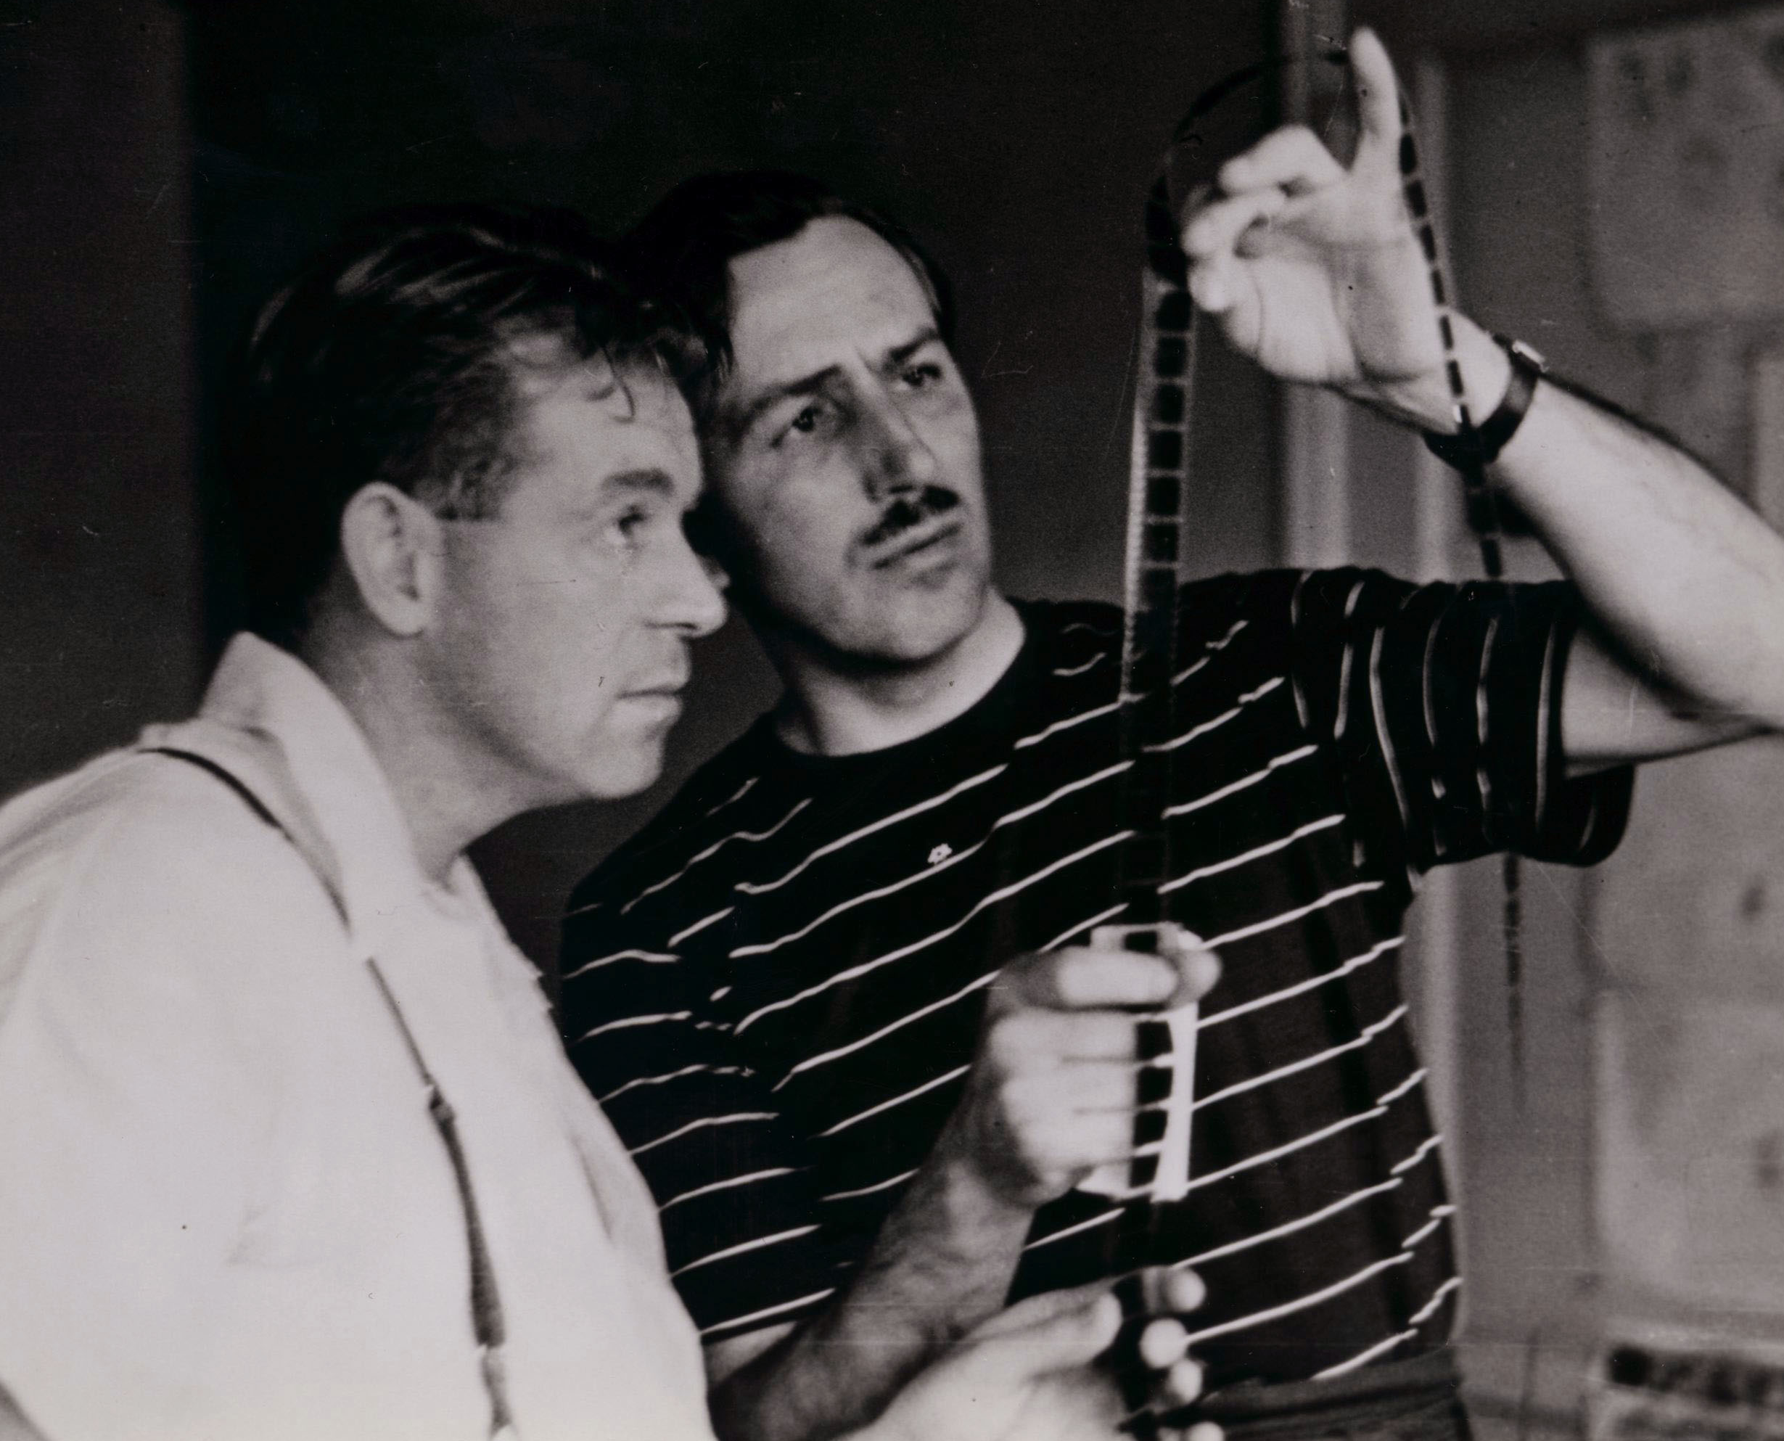
Exhibition Overview
Based on the book Directing at Disney: The Original Directors of Walt’s Animated Films written by Pete Docter and Don Peri, Directing at Disney is an exhibition from The Walt Disney Family Museum centered on prominent directors in animation who worked at The Walt Disney Studios during Walt's lifetime.
The often-unseen work of the director is crucial to the animation process: They are project managers, problem solvers, inventors, and technicians. The evolution of the role is intimately tied to the history of the animation industry. This exhibition spotlights the personalities who shaped some of Disney’s most famous cartoons.

Slide 3
Meet Pete Docter & Don Peri
Pete Docter is the Oscar®-winning director of Monsters, Inc. (2001), Up (2009), Inside Out (2015), and Soul (2020), and Chief Creative Officer at Pixar Animation Studios. Most recently, he served as the Executive Producer of Pixar’s Elemental (2023) and Inside Out 2 (2024).
Don Peri is a Disney historian and the author of Working with Walt and Working with Disney, in addition to serving as the coauthor of Walt Disney's First Lady of Imagineering: Harriet Burns. He has consulted for the Walt Disney Family Foundation and lectured on Disney history at many venues including Walt Disney Animation Studios, Pixar Animation Studios, The Walt Disney Company Consumer Products Division, Disneyland (for Cast Members), and The Walt Disney Family Museum.

Slide 4
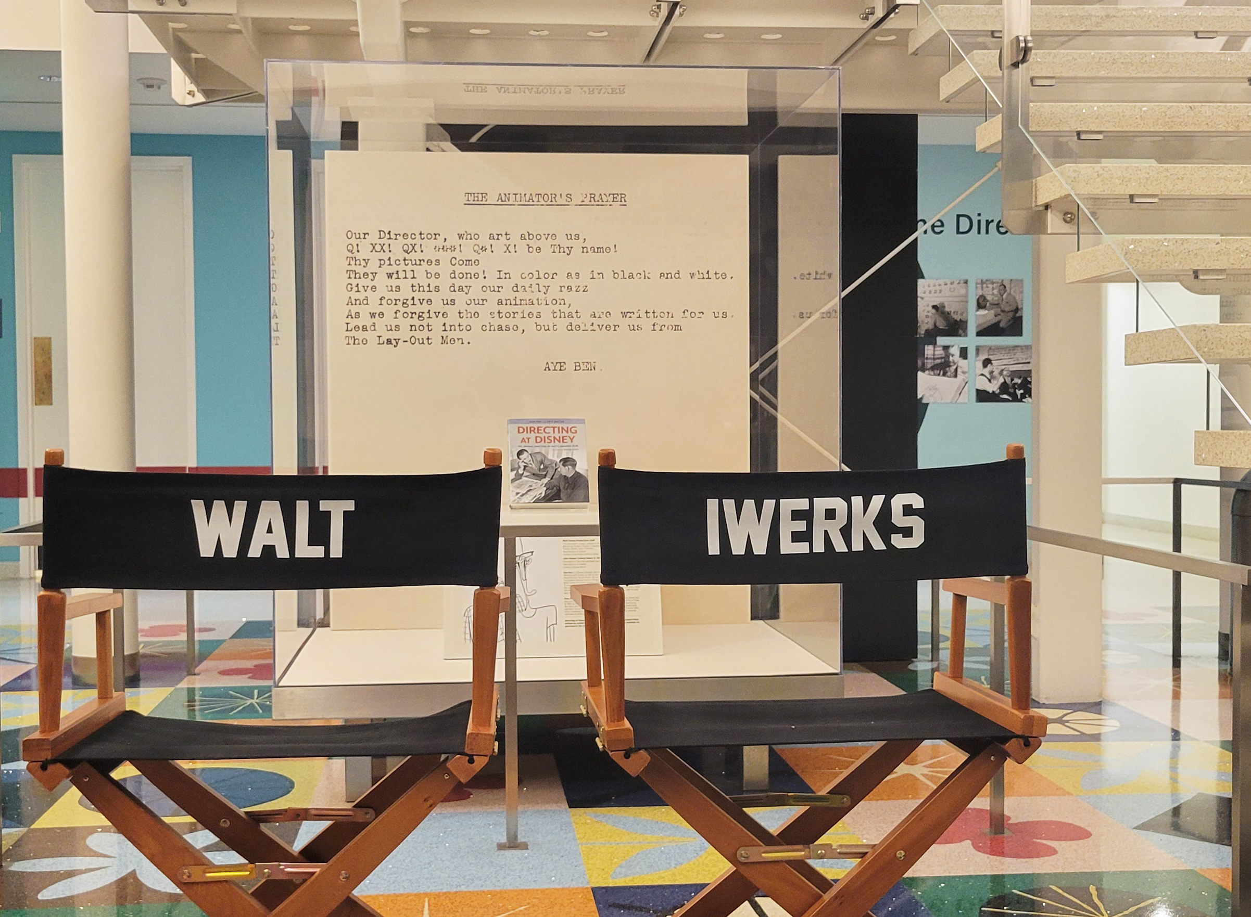
Those men who have worked closely with me in trying to organize and keep the studio rolling, and keep its chin above the water, should not be envied. Frankly, those fellows catch plenty of hell, and a lot of you can feel lucky that you don’t have too much contact with me.
—Walt Disney

Slide 5
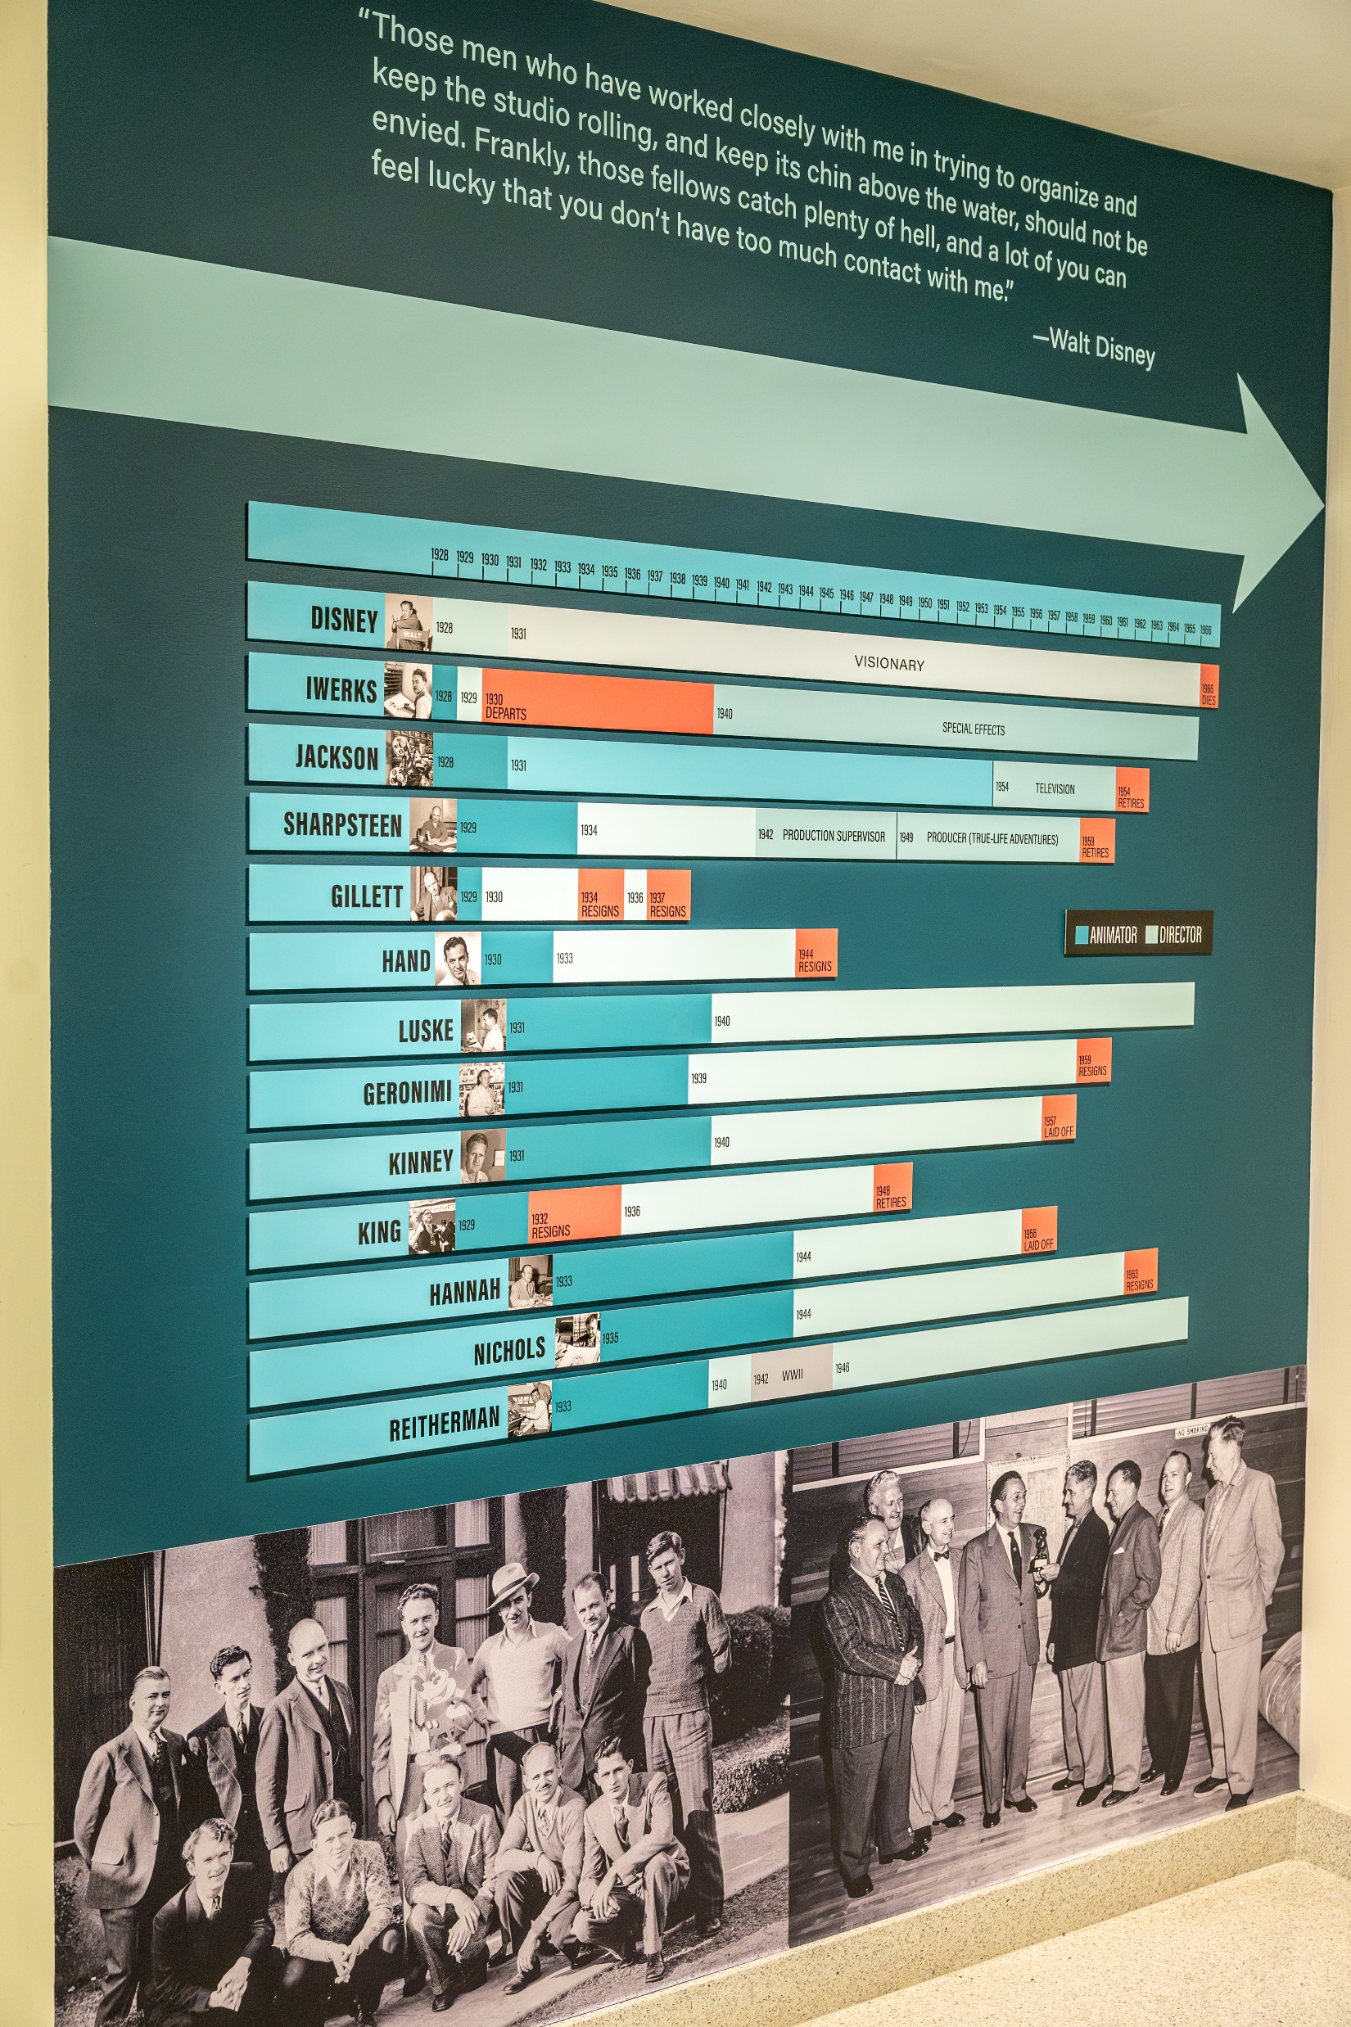
Exhibition Themes
Guests will learn about:
The lives and careers of Disney’s most prominent directors
The methods directors used to manage animators and animation
How the role of the director evolved in tandem with technological advancements and growth of the studio

Slide 6
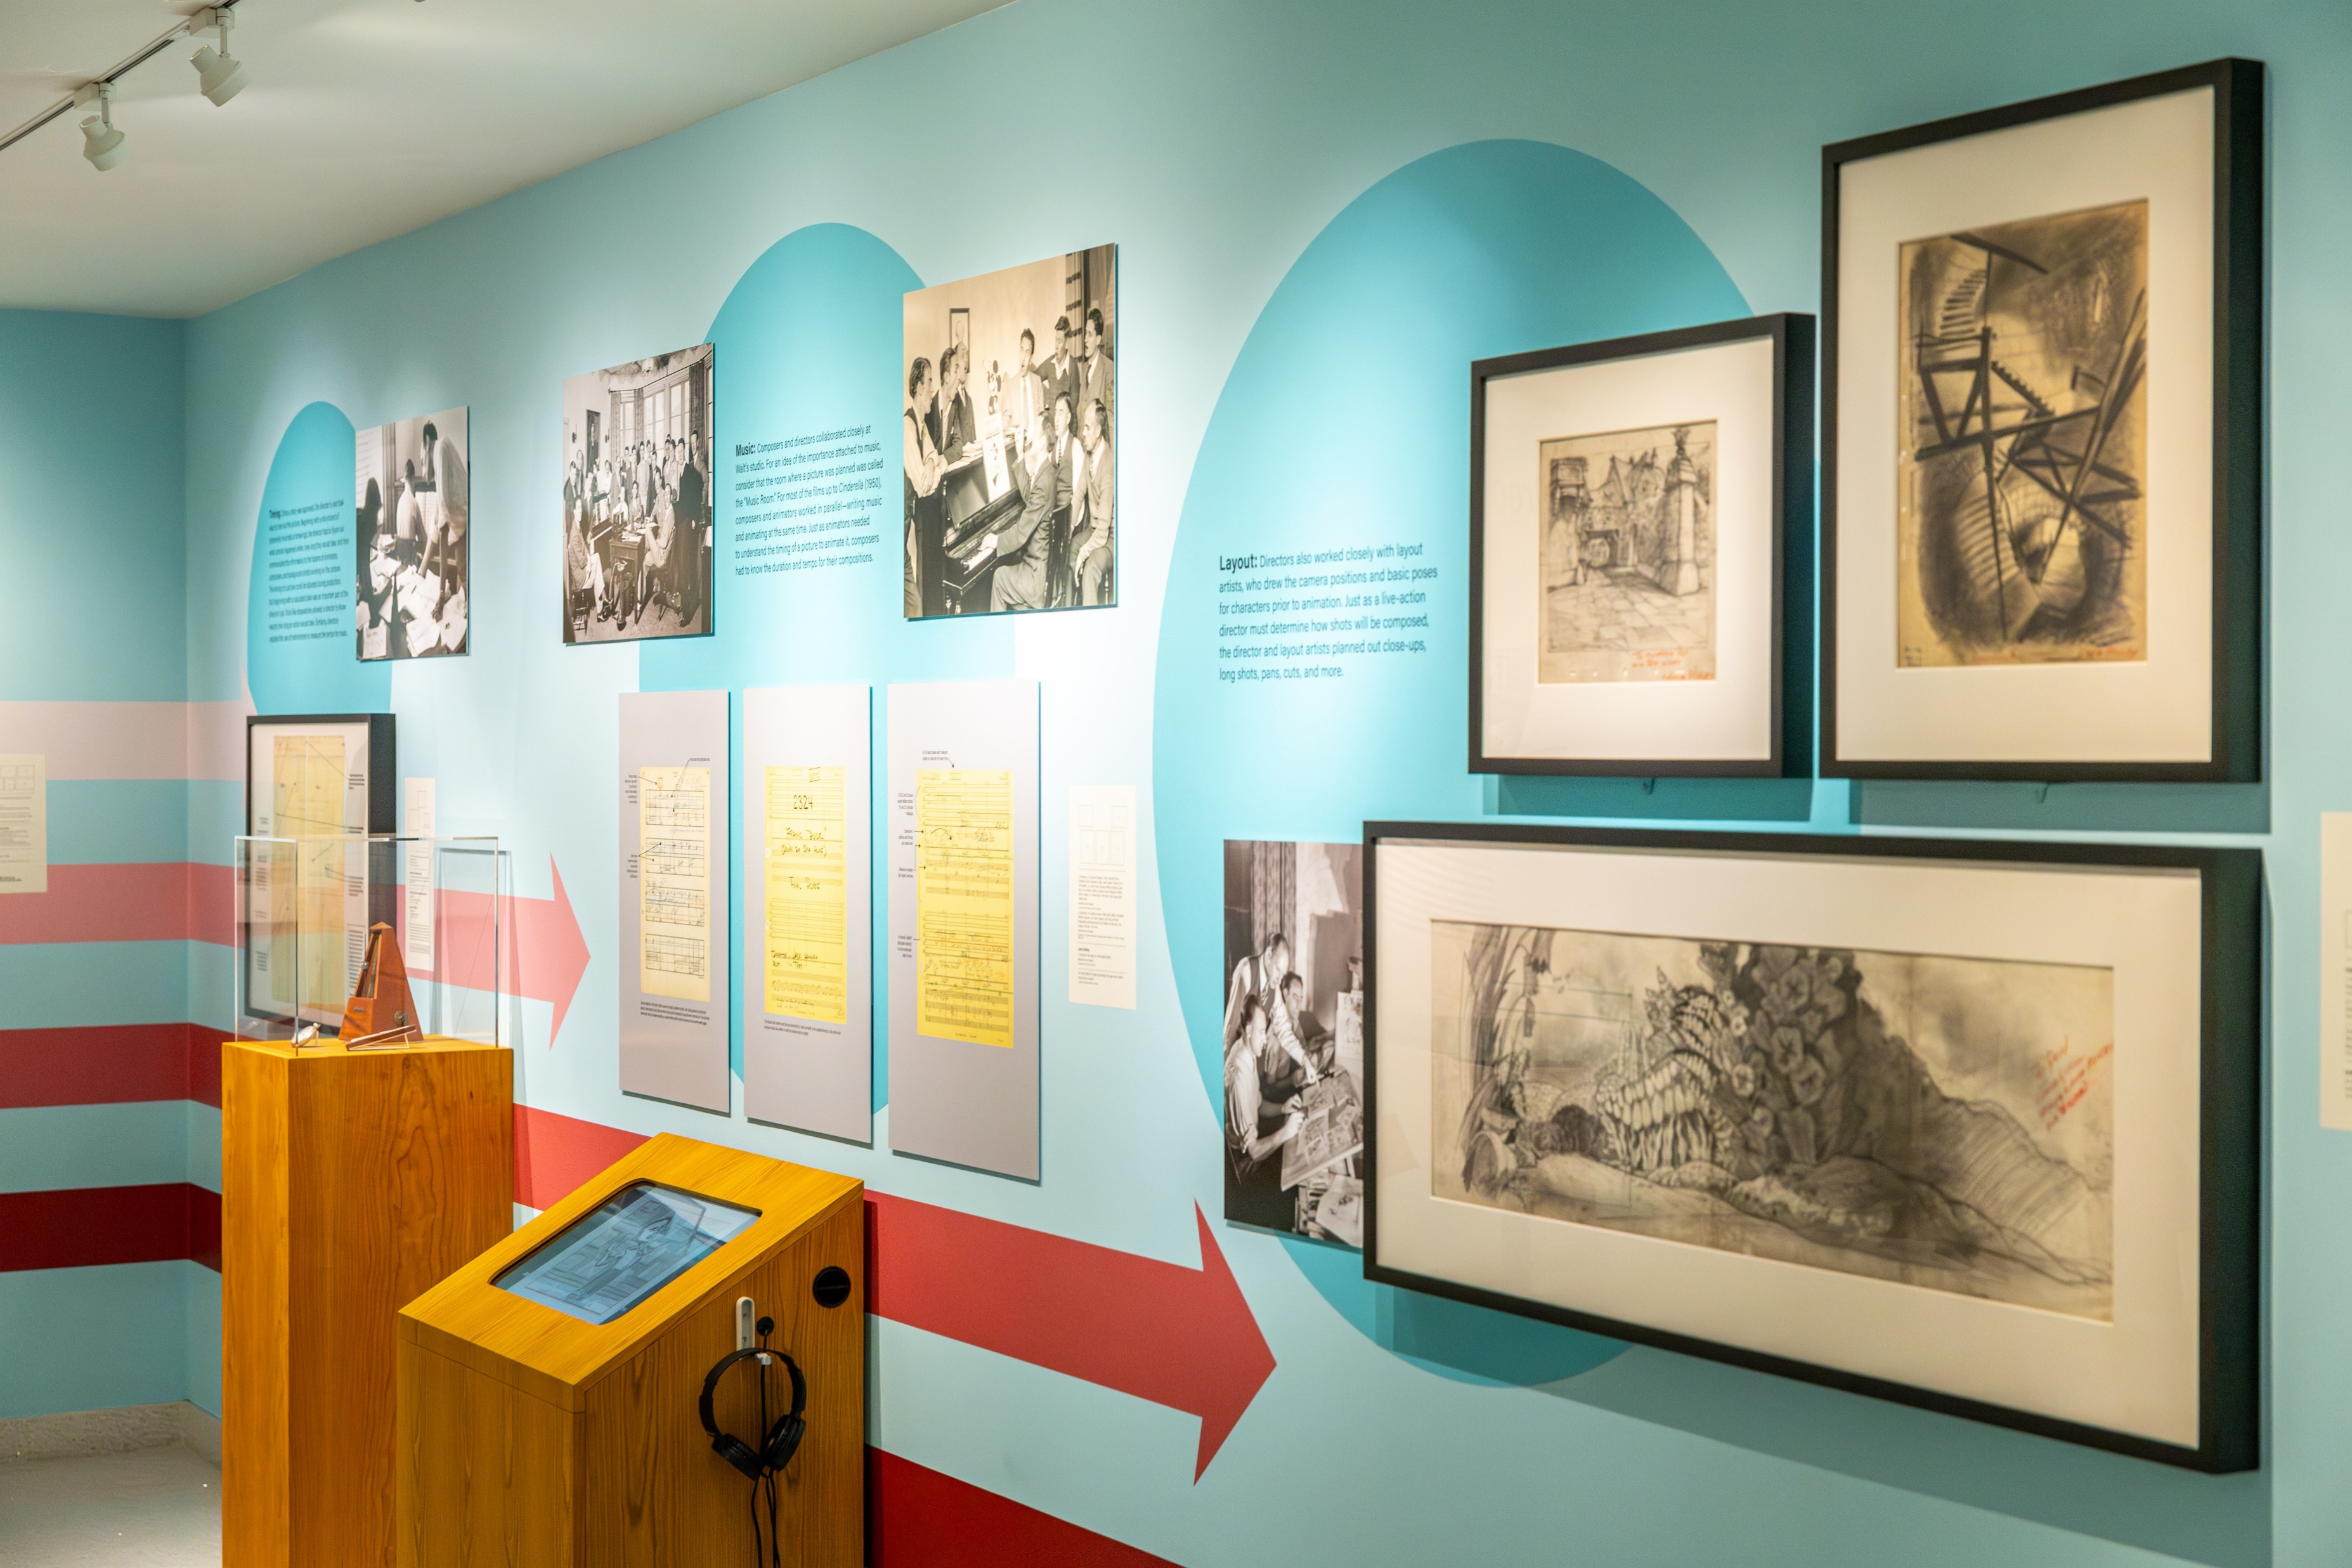
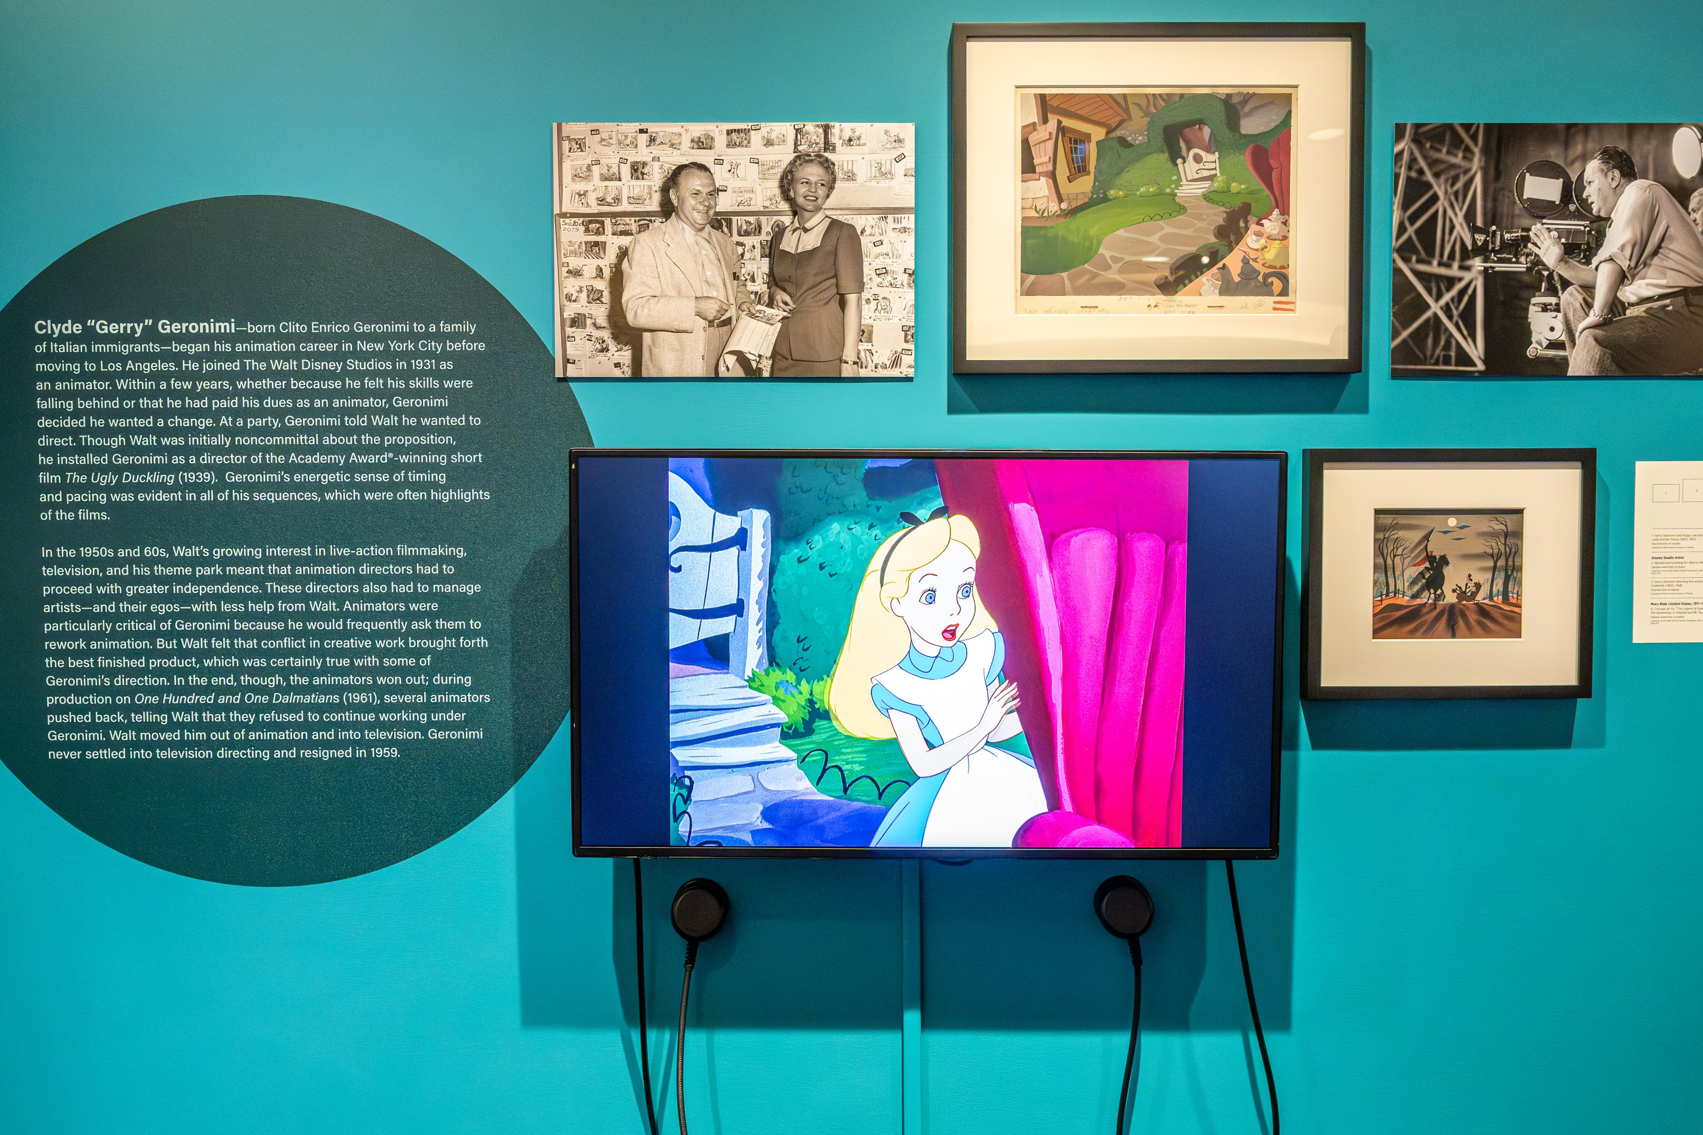
This was so intuitive about Walt: He could put his fingers on the total theme of a picture in a story so quickly. I know it influenced me all the way through The Jungle Book (1967), to go for the personalities and not get a complicated story. And then, again this guy left so many roots in all of us; all of the pictures I did since then, I went for personality, strong characterization, strong voices that fit the character. It did make the pictures ever so much simpler to construct.
— Wolfgang “Woolie” Reitherman, Animator and Director

Slide 7
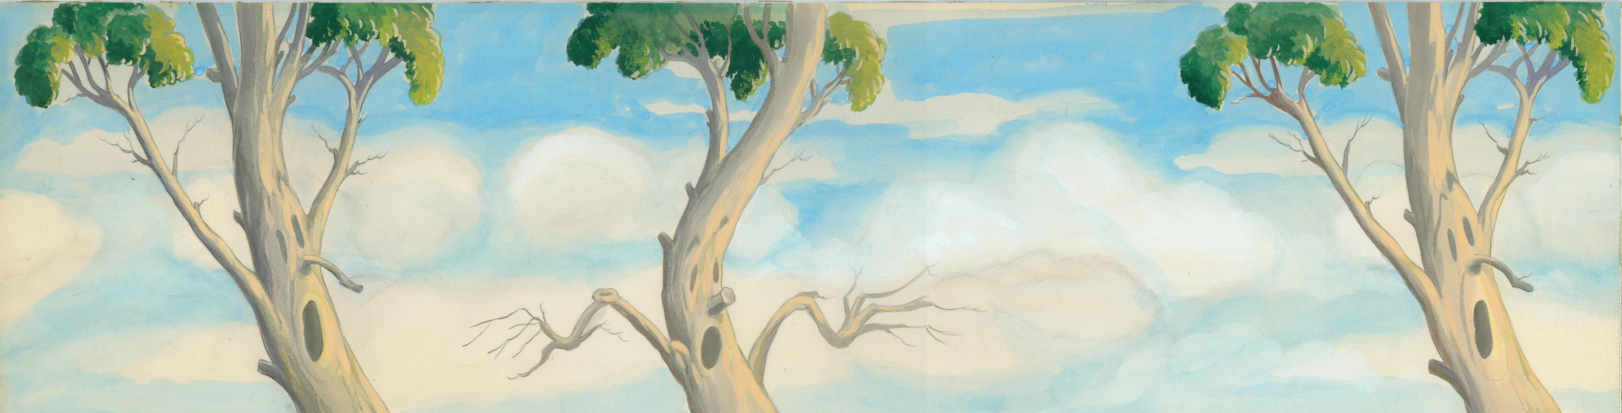
Exhibition Breakdown
47 behind-the-scenes photographs at The Walt Disney Studios
25 pieces of studio paraphernalia including interoffice communications, letters, and meeting notes
14 original artworks from different stages of the animation development process, including concept art, backgrounds, and animation drawings
2 interactive games
8 video compilations of Disney cartoons by directors featured in this exhibition
An exclusive panel video conducted by exhibition curators Pete Docter and Don Peri at the 2024 D23 Ultimate Fan Event

Slide 8
Featured Directors
Wilfred Jackson
Woolie Reitherman
Ben Sharpsteen

Slide 9
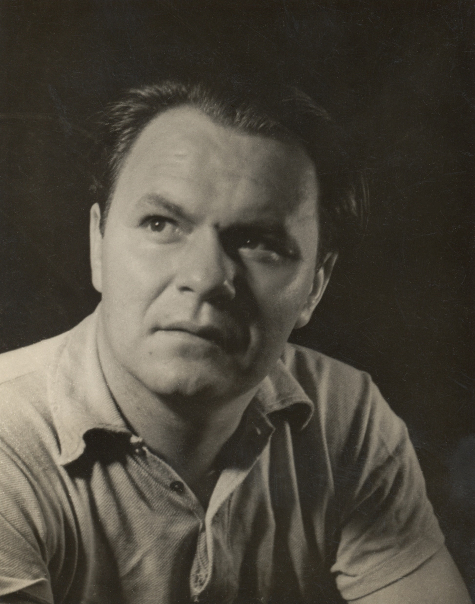
Featured Directors
Jack King
Ham Luske
Clyde Geronimi

Slide 10
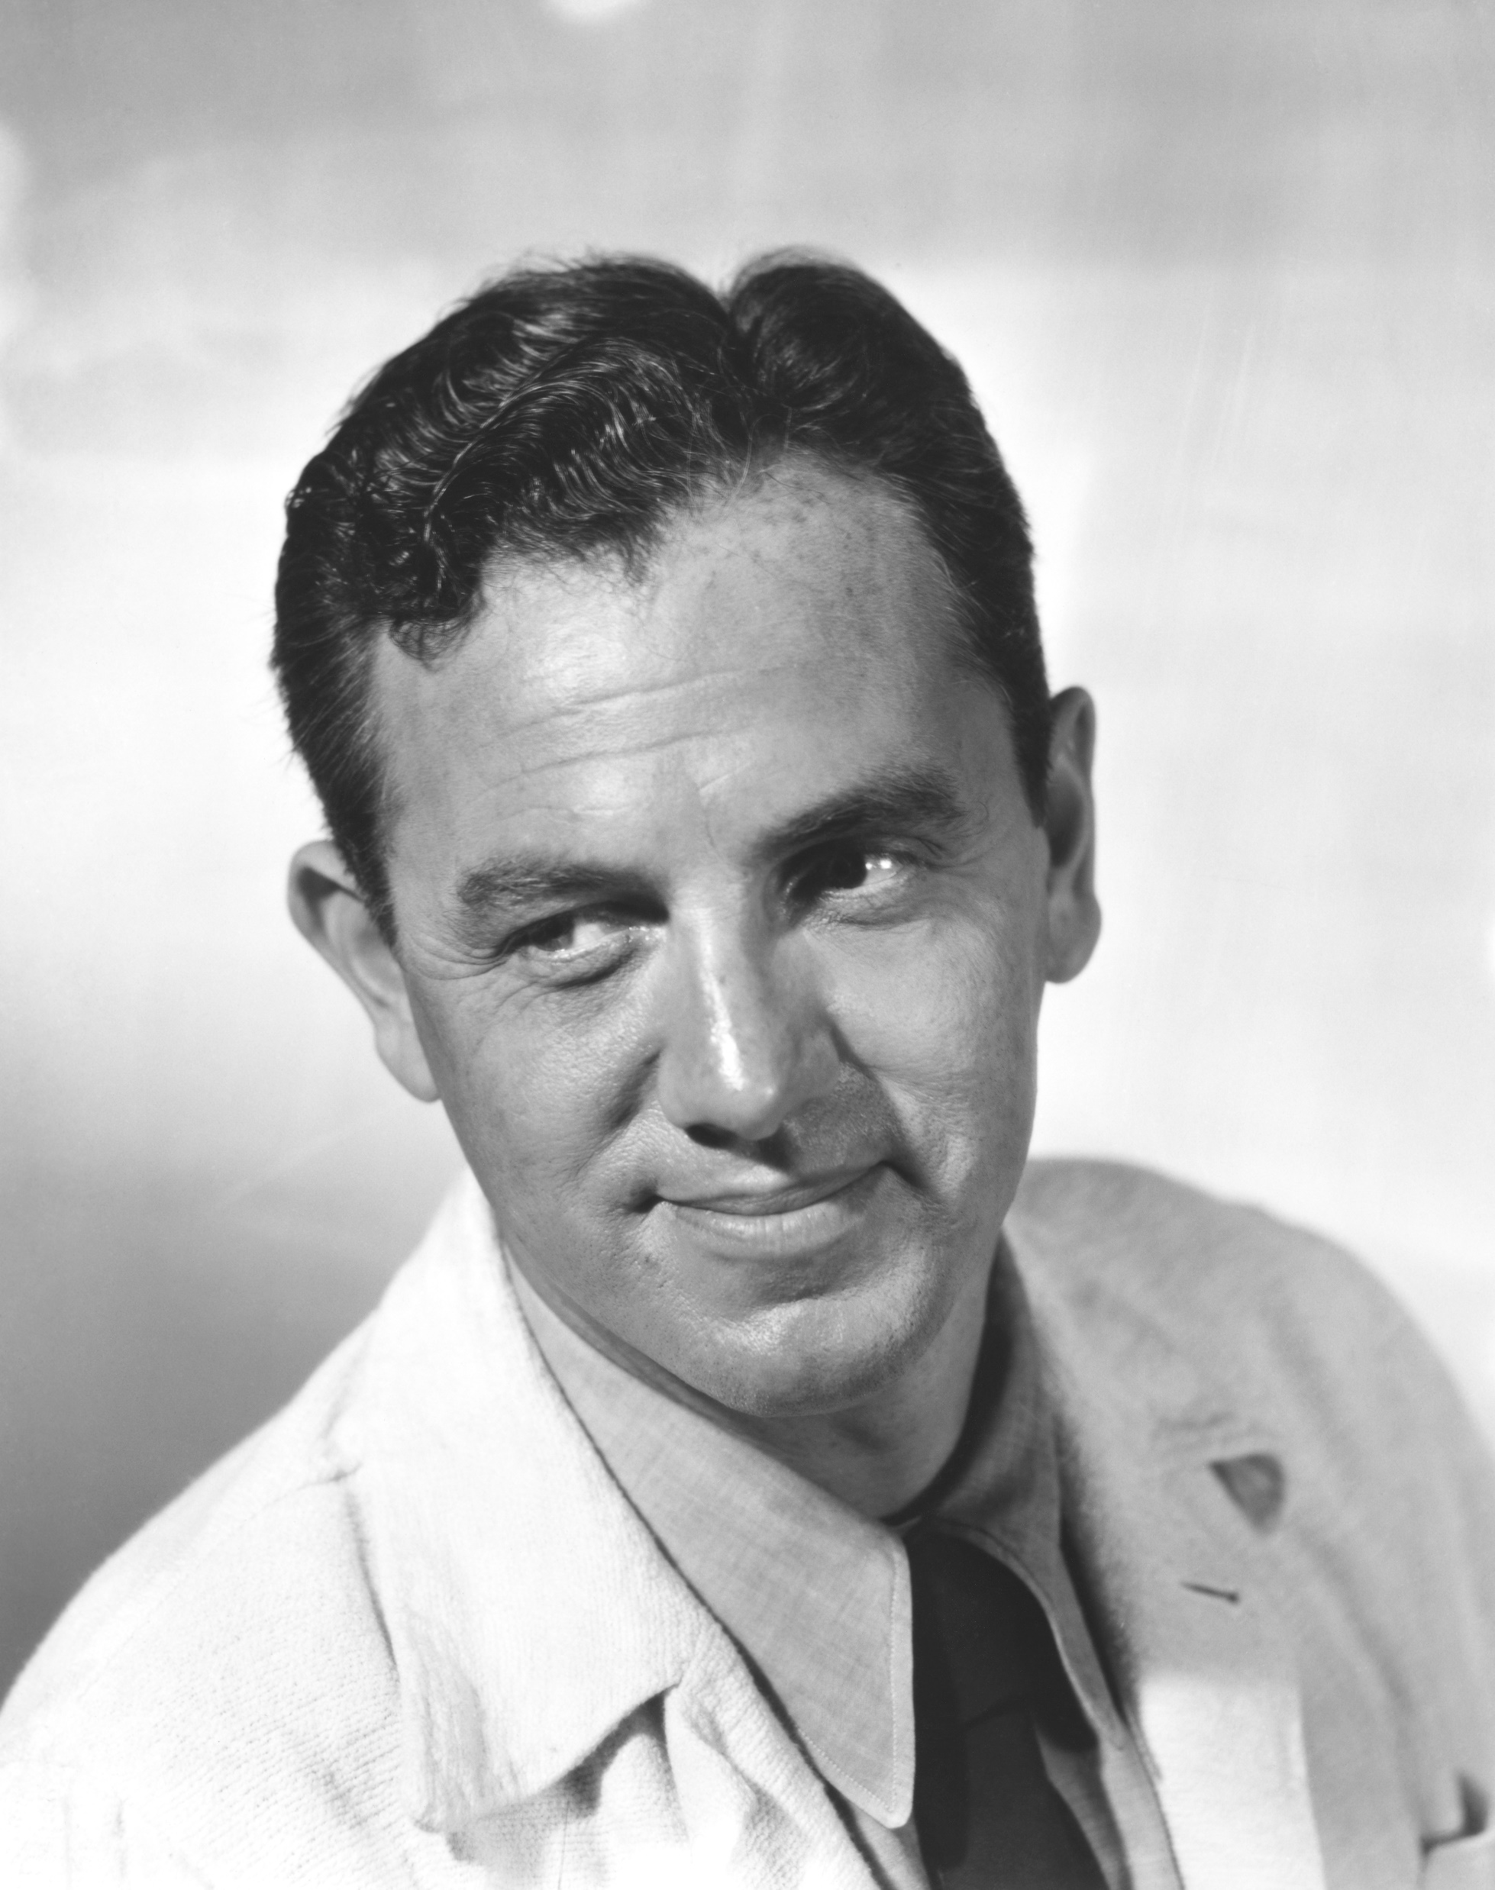
Featured Directors
Dave Hand
Burt Gillett
Jack Hannah

Slide 11
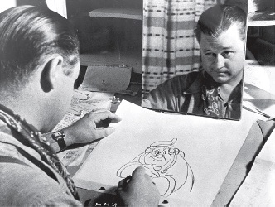
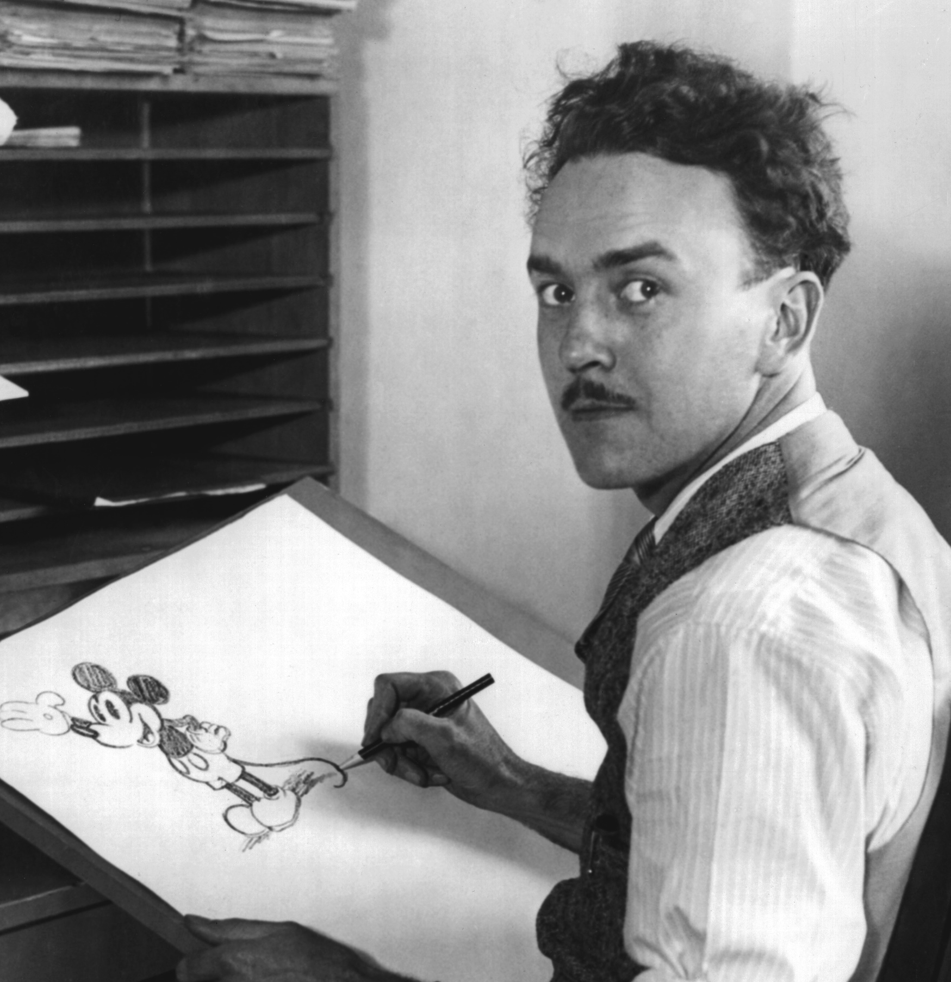
Featured Directors
Nick Nichols
Ub Iwerks
Jack Kinney

Slide 12
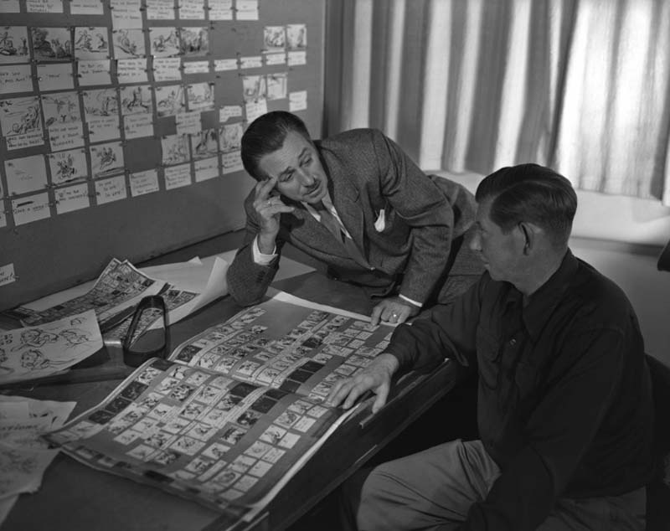
Featured Directors
& Walt Disney!

Slide 13
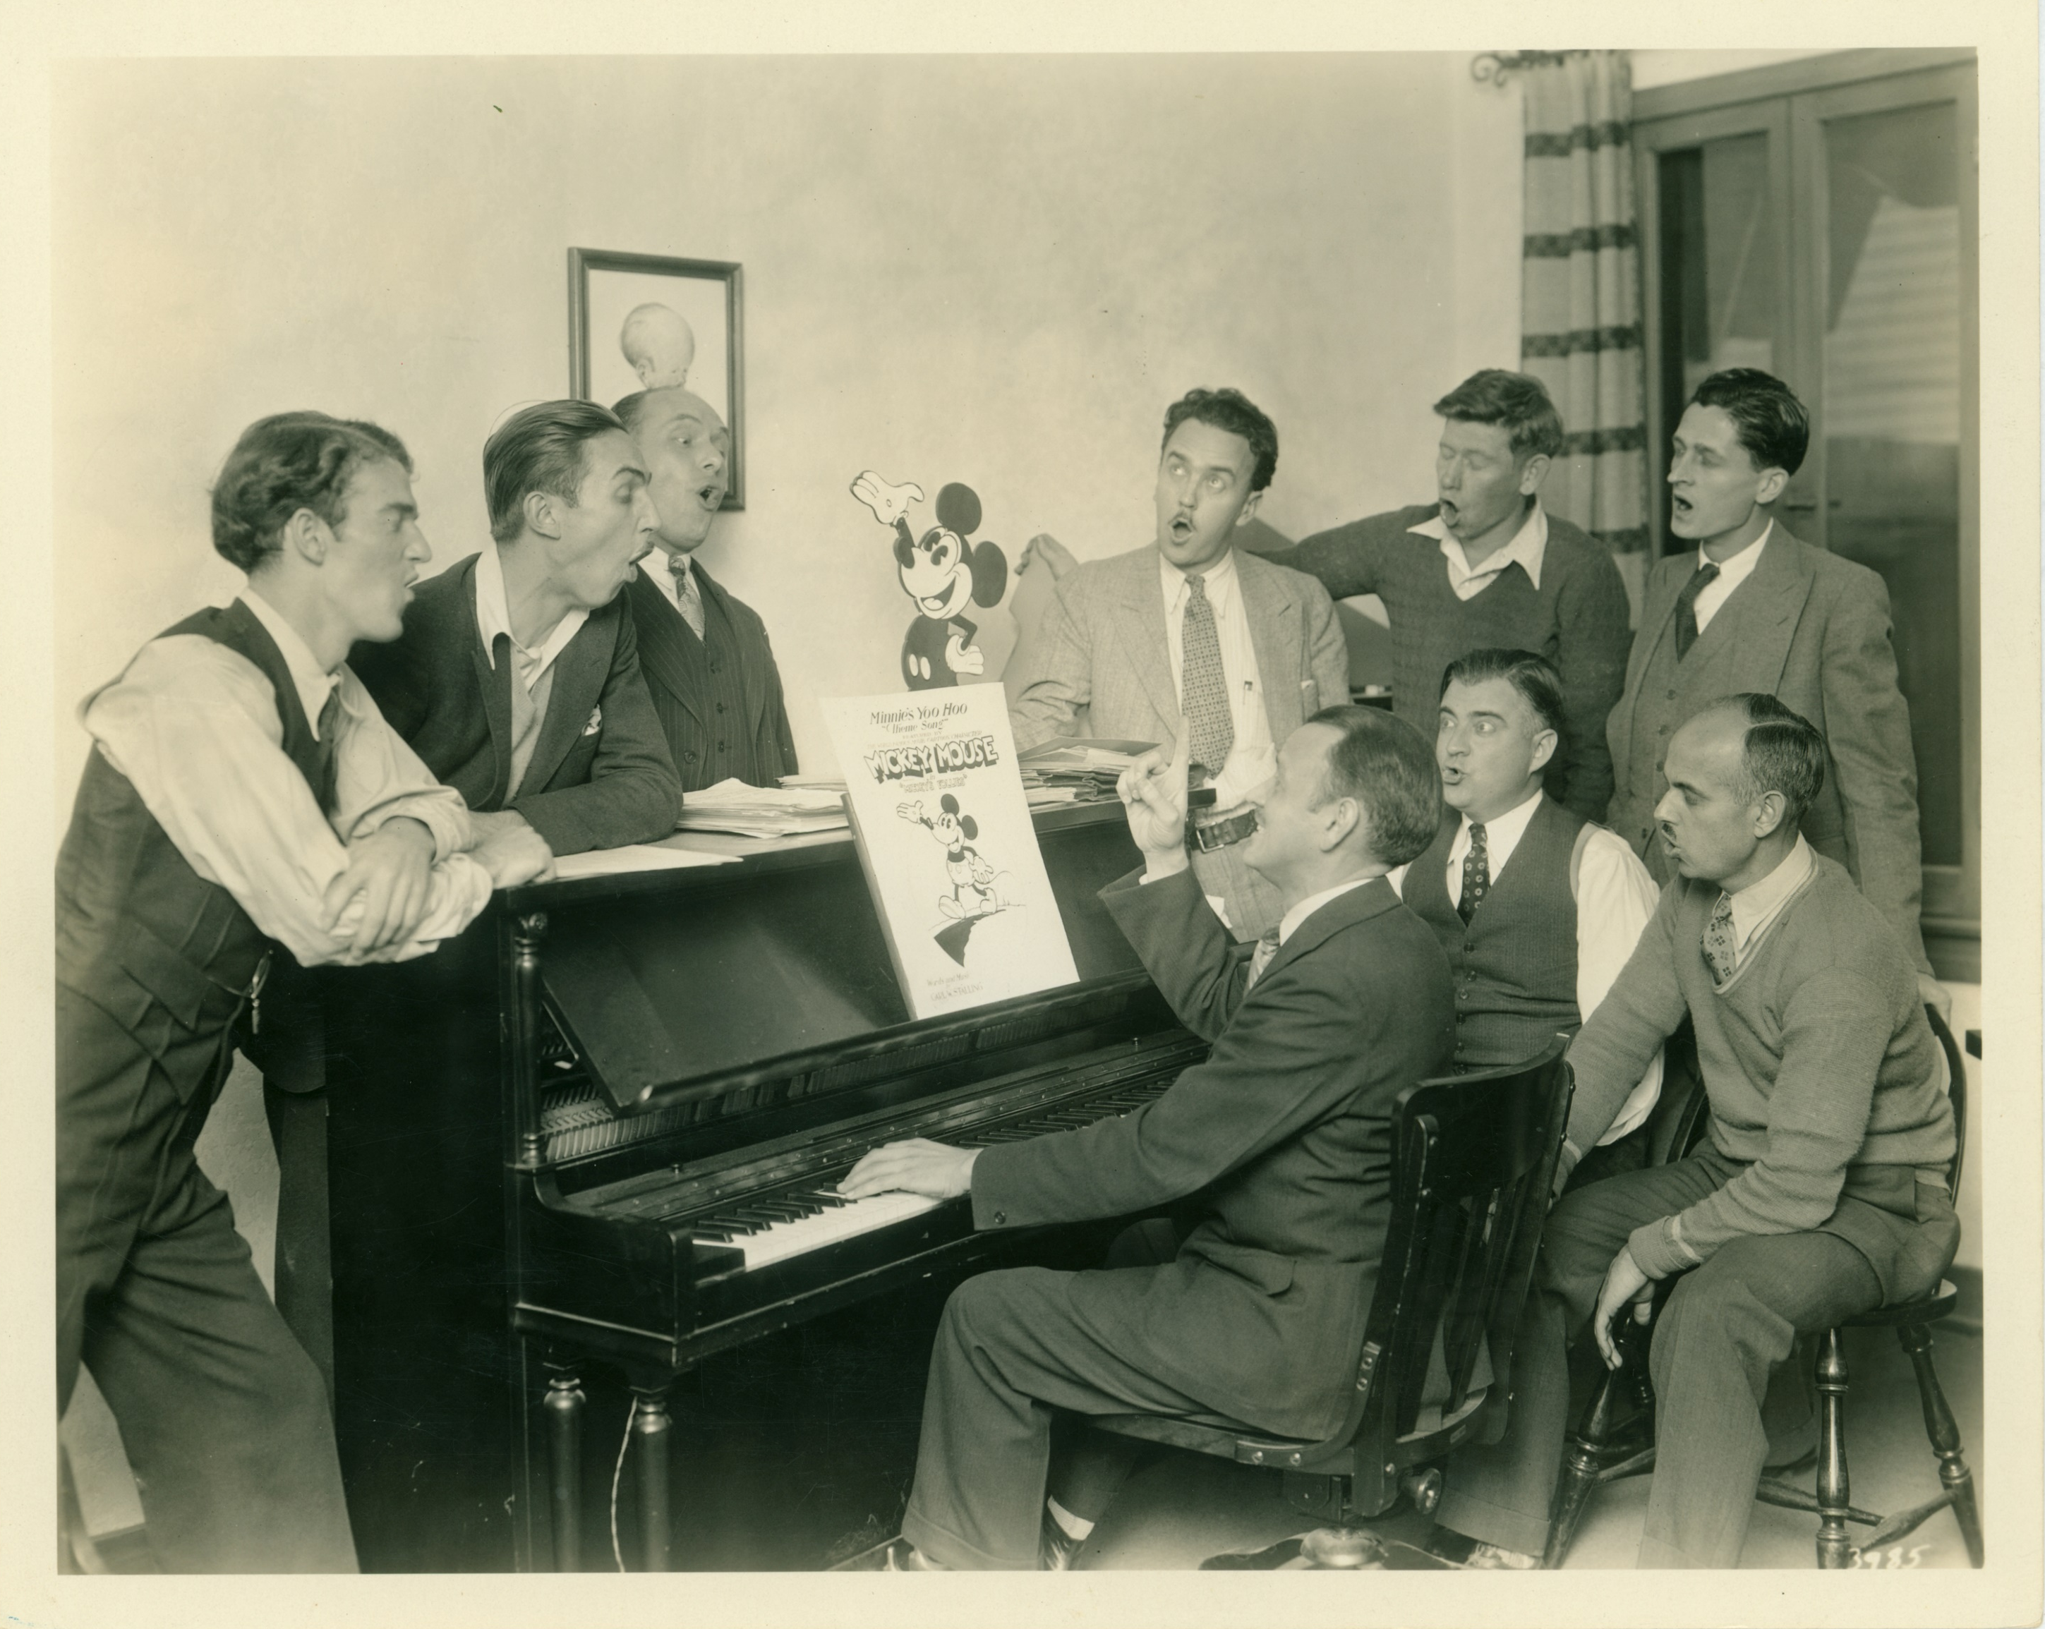
[LEFT TO RIGHT] Johnny Cannon, Walt Disney, Burt Gillett, Ub Iwerks, Wilfred Jackson, Les Clark, (seated) Jack King, and Ben Sharpsteen gathered around Carl Stalling at the piano and singing “Minnie’s Yoo Hoo”
Burt Gillett (CENTER) directing layout artists Charlie Philippi (FOREGROUND) and Hugh Hennesy

Slide 14
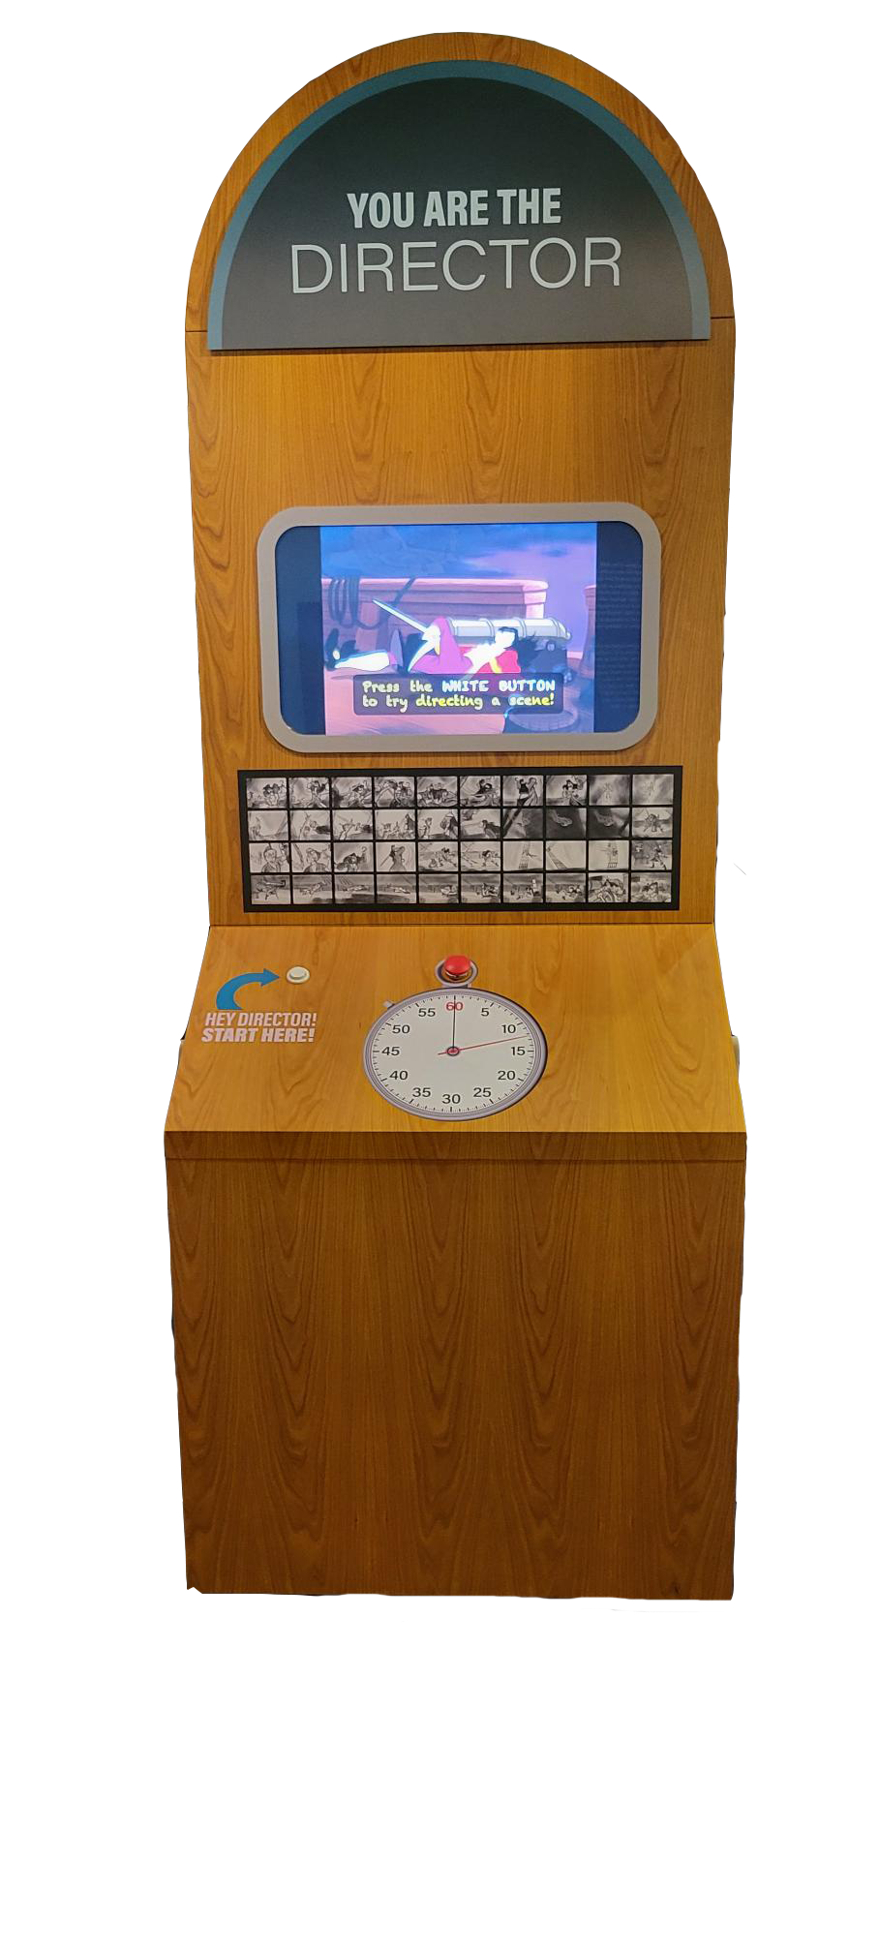
Interactive:
YOU ARE THE DIRECTOR
Experience firsthand how an animation director uses timing and sound together to shape a scene. Press the button to determine how long each storyboard frame should appear on screen. Afterwards, review how the scene feels with your timing.

Slide 15
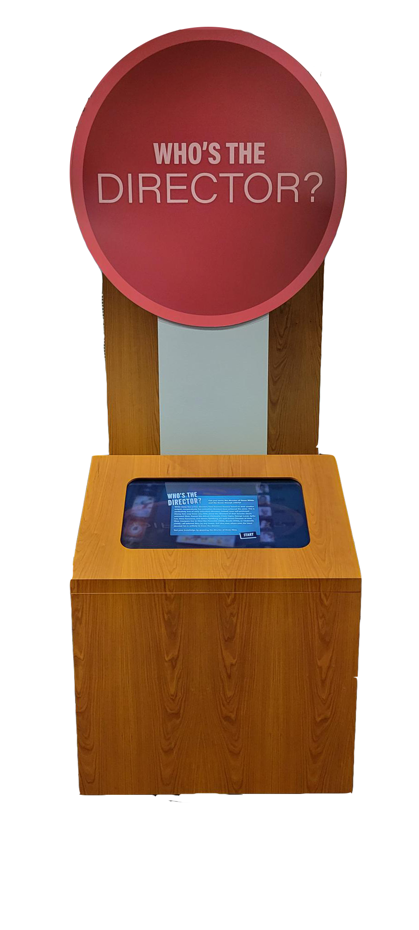
Interactive:
WHO'S THE DIRECTOR
In this interactive quiz, test your knowledge of film and animation history by matching directors with the films they made.

Slide 16
For more information, please contact
MARINA VILLAR DELGADO
Director of Exhibitions and Collections
mvillar@wdfmuseum.org

